Slide 1














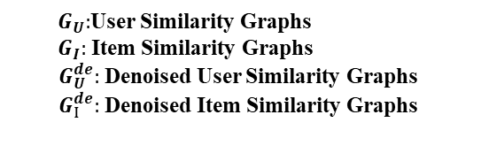


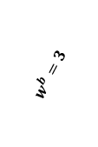







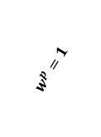


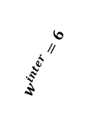


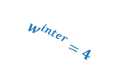








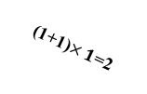


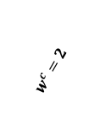






p: page view c:cart b:buy
$$p<_{beh}c<_{beh}b$$
$G_{R}^{p}:Graph p$ $G_{R}^{c}:Graph c G_{R}^{b}:Graph b G_{R}^{p,de}:denoised Graph p$ $G_{R}^{c,de}:denoised Graph c$ $G_{R}^{b,de}:weighted Graph b$
$$w^{p}=1<w^{c}=2<w^{b}=3$$
Intra-Behavior Weighting
Weight Fusion and Denoising
$$G_{R}^{p}$$
$$G_{R}^{p}$$
$$G_{R}^{p,de}$$
$e_{u}:$User Embedding
2
2
1
$$⊕$$
5
3
Weighted Denoising GNN
$e_{i}:$Item Embedding
$$w^{p}=1$$
1
2
1
1
1
6+1=7
1+4=5
Prediction
6
5
5
1+3=4
$e_{p}:$p Behavior Embedding
$e_{c}:$ c Behavior Embedding
$$G_{R}^{c}$$
$$G_{R}^{c}$$
$$G_{R}^{c,de}$$
$e_{b}:$ b Behavior Embedding
$$⊕$$
Denoising-informed Inter-Behavior SSL
$$w^{c}=2$$
1
2
(1+0) $×1$
1
6+1=7
6
5
(1+1)$×1$=2
2+4=6
1+3=4
$$𝓛_{inter_ssl}$$
$$G_{R}^{b}$$
$$G_{R}^{b}$$
$$G_{R}^{b,de}$$
$$w^{b}=3$$
1
1
1
$$⊕$$
5
$$G_{r}^{b}$$
$$G_{r}^{aug}$$
1
1+6=7
5
1+4=5
$$G_{r}^{aug}=G_{r}^{b,de}+HighWeightSample(G_{r}^{c,de}+G_{r}^{p,de})$$
$$w_{ui}^{intra,k}=\left(1+\text{Co}\text{−}\text{Intereaction}\right)×R_{ui}^{k}$$
$$w_{ui}^{com,k∈\{p,c,b\}}=w_{ui}^{intra,k}+w_{ui}^{inter}$$
Denoising-informed Intra-Behavior SSL
$$G_{U}$$
Inter-Behavior Weighting
$$G_{U}^{de}$$
Pull
Pull
$$G_{I}$$
1
$$w^{inter}=4$$
$$w^{inter}=6$$
$$3$$
4
4
$$w^{inter}=3$$
$$4$$
$$G_{I}^{de}$$
Push
Push
$$w_{ui}^{inter}=w^{p}{×R}_{ui}^{p}+w^{c}{×R}_{ui}^{c}+w^{b}{×R}_{ui}^{b}$$
$$G_{U}^{de}$$
$$𝓛_{inra_ssl}$$
$$G_{I}^{de}$$
${ G}_{U}:$User Similarity Graphs
${ G}_{I}:$ Item Similarity Graphs
$G_{U}^{de}:$ Denoised User Similarity Graphs
$G_{I}^{de}:$ Denoised Item Similarity Graphs
Inter- and Intra-behavior Weighted Denoising Module
Denoising-informed Inter- and Intra-behavior Representation Enhancement Module
Notes:
TODO 行为内加权

